Slide 1

Operating Systems Project
on
Snapshot of File System
Submitted by,
Aishwarya Shivachandra(2018202005)
Divyanshi Kushwaha(2018201046)
Kopal Agarwal(2018202015)
Shafiya Naaz(2018201062)
Guided By,
Prof. Manish Shrivastava
Juhi Gupta (TA)

Slide 2
Problem Statement
AIM :
To develop an application in C++ to generate snapshots of a file system, so that a user can look at the file system as it appeared at that point in the past.

Slide 3
Introduction
A snapshot is a copy of a file system at a specific point in time, even while the original file system continues to be updated and used normal
A snapshot of an entire file system can be created to preserve the contents of the file system.
Snapshots also provide a backup capability that allows easy recovery from common problems such as accidental deletion of a file.

Slide 4
Functionalities Covered
Preserving attributes of entire file system.
Creating snapshot by copying only the changes from the existing files/directories rather than complete copy.
Minimizing space and time complexity while creating snapshot.

Slide 5
Functionalities Covered
Computation of weak and strong checksums for fixed-sized chunks of each file
Comparison of changes in the files using the checksums
Writing only the changes in the snapshot

Slide 6
Functionalities Covered
Rolling checksum
The weak rolling checksum used in the algorithm needs to have the property that it is very cheap to calculate the checksum of a buffer X2 .. Xn+1 given the checksum of buffer X1 .. Xn and the values of the bytes X1 and Xn+1.

Slide 7
Functionalities Covered
Md5
The MD5 message-digest algorithm is a widely used hash function producing a 128-bit hash value.
It is used as strong checksum.

Slide 8
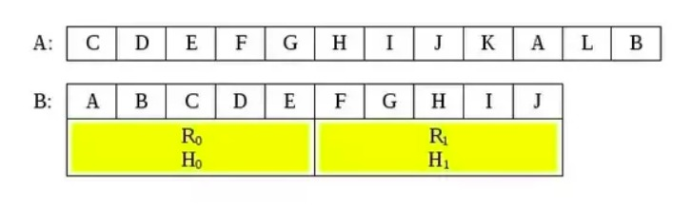
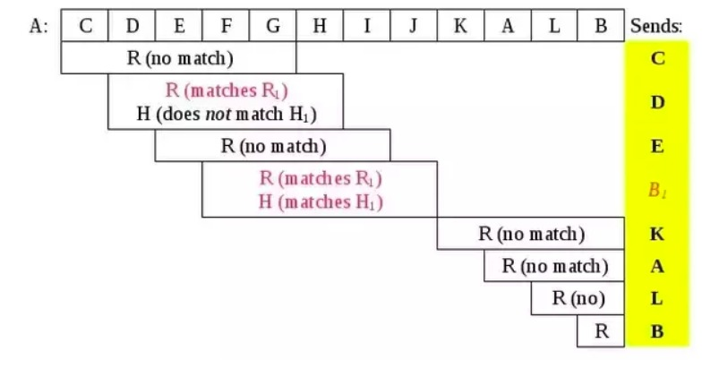
Algorithm used: Rsync
To sync File A with File B

Slide 9



Computation of Rolling Checksum
Formulae used:

Slide 10
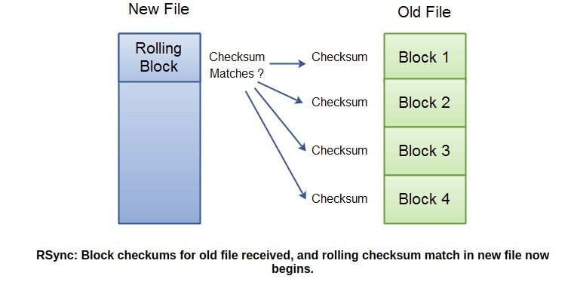
Algorithm used: Rsync
Comparison of files using the rolling checksums

Slide 11
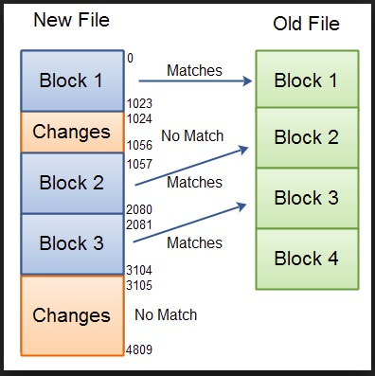
Algorithm used: Rsync
Storing changes and matched chunk’s index in a data structure.

Slide 12
File Attributes
Each file has the following attributes :
The file mode which determines the file type and how the file's owner, its group, and others can access the file.
The User ID and Group ID of the file.
The size of the file in bytes.
Timestamps (ctime, inode change time), (mtime, modification time), and last accessed (atime, access time).
which are retrieved using the stat system call and preserved in the snapshot.

Slide 13
Directory Traversal
Used functions of “dirent.h” such as opendir(), readdir(), etc. in order to recursively traverse the entire file system .
Compared the last modified time of source and its corresponding snapshot file and proceeded with further computations only when the two modified times were found to be different.

Slide 14
Challenges Faced
Applying Rsync algo for whole directory structure.
In storing only the changes rather than copying the whole content.
Implementation of checksums.

Slide 15


